Slide 1


High Performance Computing:
Renewable Energy Solutions
Kate Pendavinji
Notes:
Hello, my name is Kate Pendavinji and tonight I will be discussing how high performance computing is helping us arrive to solutions surrounding renewable energy.

Slide 2

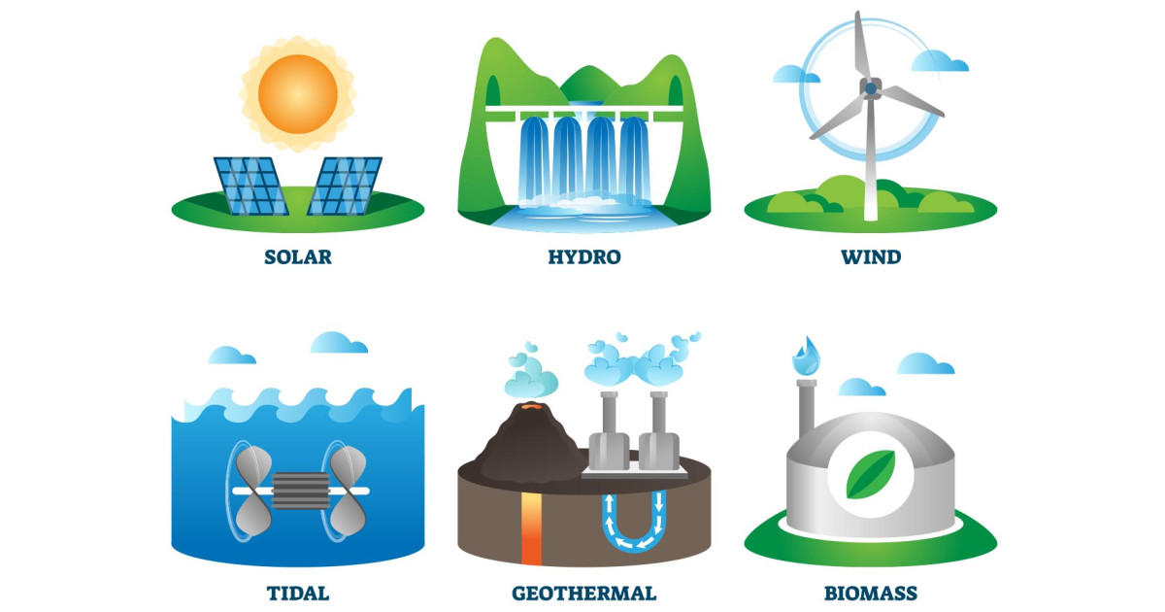
Politics & History
Gas prices these days!
Fossil fuels powering our farms– prices devastate local users
Evident urgent necessity for clean options
Climate emergency declarations from 38 countries since 2016
Live Green
Notes:
Most of us are familiar with the recent increase in gas prices. Due to various political elements existing within and outside the U.S. many demographics are devastated by these price increases. It begs the question of how we can evolve from our current fossil fuel consumption at a local level as well as a global level. Obviously the discussion surrounding gas is very topical, but it presents a very tangible image of exactly how urgent our necessity for modern applications of renewable energy is. Since 2016 38 countries including the United States have declared a state of climate emergency.

Slide 3


Politics & History
Environmental Ethics: who’s in charge of fixing all of this?
Bjørn Lomborg: False Alarm
Technology and innovation are not only the way of the future, but the solution!
High performance computing is paving the way for renewable energy and climate science
Live Green
Notes:
The issue of climate change and resolving our energy crisis is a large topic of discussion in regards to environmental ethics. Bjorn Lomborg who was the director of the Danish Government's Environmental Assessment Institute shared a sentiment which we generally are not used to hearing in the urgent state that climate is normally in and that is to not panic. He revealed that one of the most promising ways which we will have to fight climate change is through dynamic production of technical solutions which is something engineers have been developing for quite some time now. Most pertinent to our discussion is the role that high performance computing plays in renewable energy optimization.

Slide 4
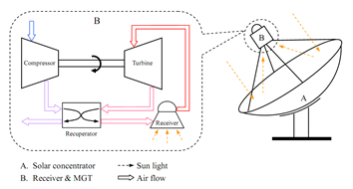
Renewable Energy & HPC
February 2013: Solar power research kickstart– OMSoP Released in 2015
Live Green
Notes:
In February of 2013 a research project called OMSoP was initiated by the EU with a limited time requirement to achieve a system which combines solar power energy with micro-gas turbines in order to potentially create a new, effective renewable energy source. The project resulted in a EU-China collaboration which lead to the release of OMSoP at the EU-China summit in 2015. The goal was that this energy system could produce 3-10 kW of electricity– nothing earth shattering, but it was a pretty early concept which was intended for local scale use such as powering houses and potential further technical application such as electric cars. The involvement on this project required high performance computing utilizing clusters in order to run complex design simulations in a short amount of time. They also required HPC for system integration and demonstration.

Slide 5
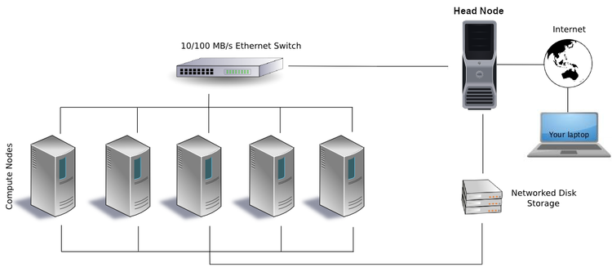
Renewable Energy & HPC
Clusters
Live Green
Notes:
The use of clusters allowed this to be conducted more time efficiently than without high performance computing. Clusters are comprised of mass quantities of compute nodes which utilize scheduling programs in order to execute tasks. They have the ability to provide parallel connection of clusters which allows for optimal performance often used in research labs such as we saw with OMSoP. Using large clusters can permit wide-scale data collection and provide researchers with real time analytical results about their work.

Slide 6
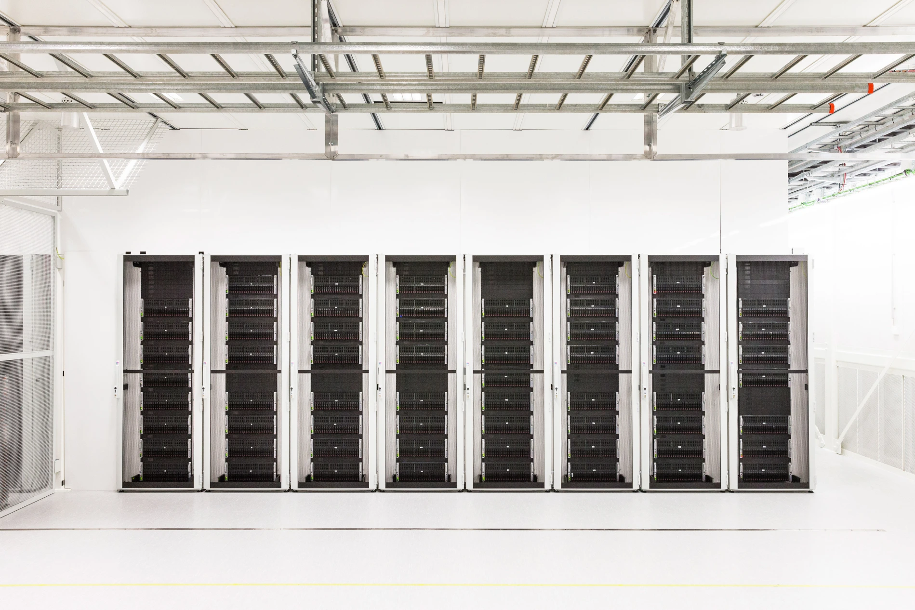
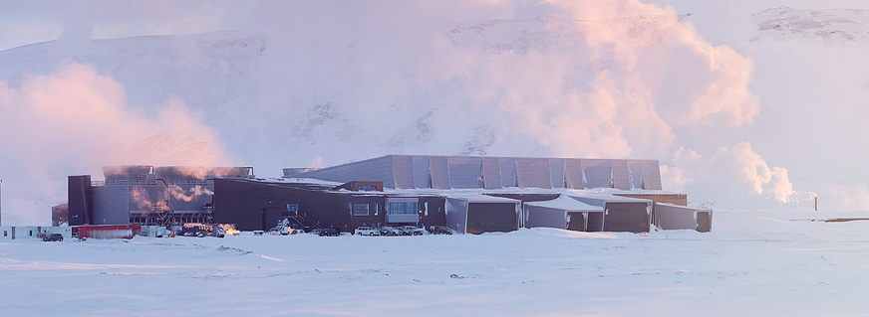
Renewable Energy & HPC
Aren’t data labs and server farms bad for the environment?
“100% of power consumed by HPC is converted to heat energy”
How to cool without using so much energy
Data centers burning diesel for temperature controls
Notes:
At surface level, having huge labs filled with super computer servers to solve climate change does seem counterintuitive. To put it into perspective 2010 NVIDIA Tesla GPU’s powered the world’s fastest supercomputer at the time with an energy consumption of 4.04 megawatts. This was considered great for the time, but was incredibly costly financially and electricity-wise. As more and more supercomputers and data labs are in demand people are considering outsourcing labs to colder climate areas, utilizing coolants, and etc. The photos on this slide are of data labs in Iceland. The colder climate of Iceland makes cooling cheap, but it’s highly unsustainable to just transform the natural land into mass data labs. These methods alone are unreliable especially when trying to solve climate issues computationally.

Slide 7
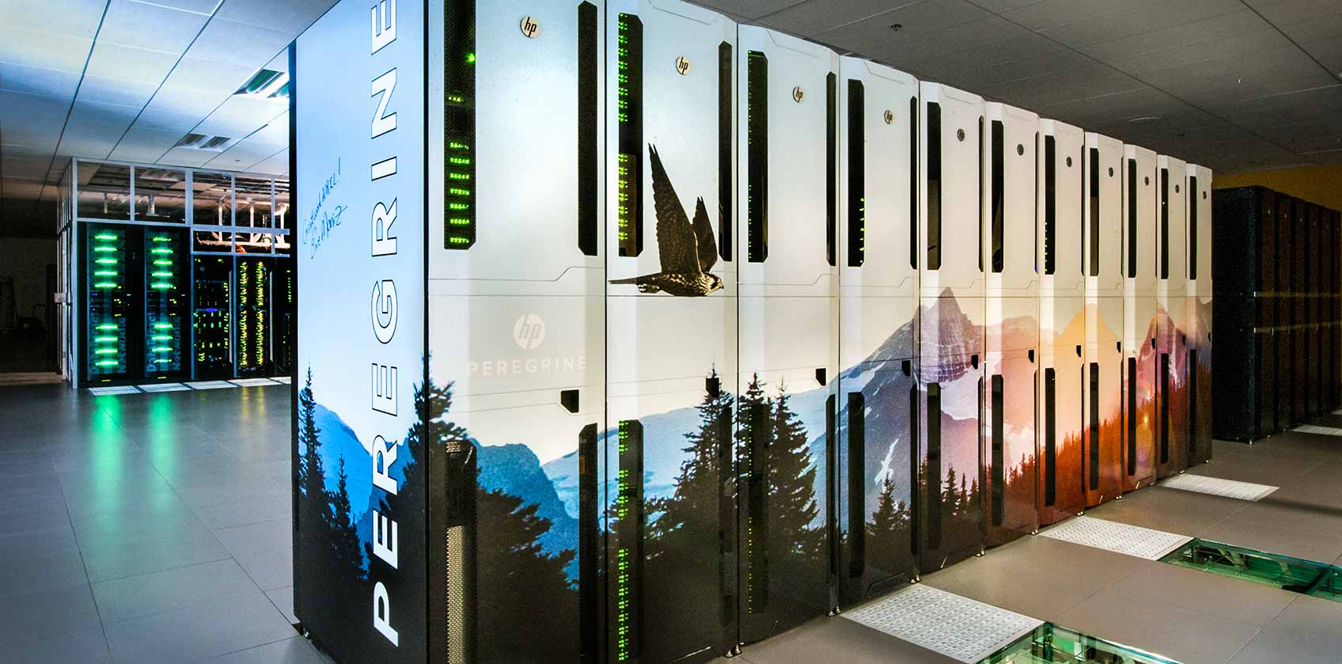
Peregrine @ NREL
Peregrine: supercomputer in Golden, Colorado located in the U.S. Department of Energy’s National Renewable Energy Laboratory (NREL)
1440 computational nodes
“Worlds most energy-efficient data center”
Live Green
Notes:
Luckily supercomputers focused on renewable energy and climate change are strongly considering this. The 2014 era supercomputer, Peregrine, located at NREL or the U.S. Department of Energy’s National Renewable Energy Laboratory, in Golden began construction in 2011. It was regarded as the world’s fastest HPC system with speeds as fast as 1.2 Petaflops dedicated to renewable energy and energy efficiency. It features state of the art warm water cooling in conjunction with waste heat reuse. In its first phase of construction it featured air-cooled nodes which later transitioned to phase 2 water-cooling nodes in 2013. Peregrine received an average PUE or power usage effectiveness rating of 1.06 which is right on the ideal rating of 1.0.

Slide 8
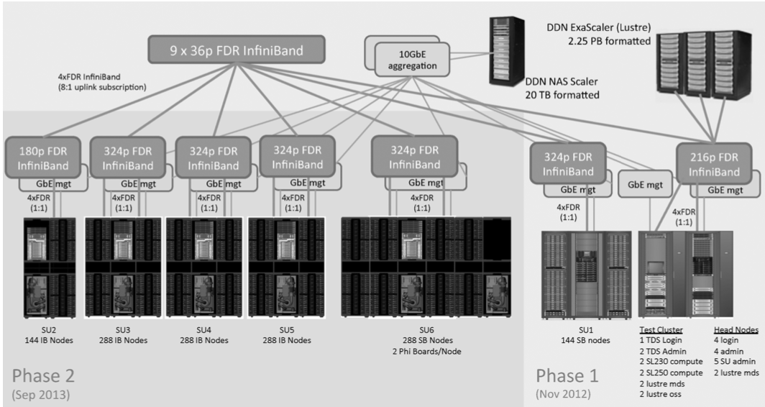
Peregrine @ NREL
Live Green
Notes:
Here you can more closely see the evolution from phase 1 to phase 2. Peregrine utilized both IvyBridge processors as well as SandyBridge processor based compute nodes which used liquid cooled heat capture and reuse enclosures to ensure energy efficiency among compute nodes for high quality graphics processing. Peregrine allowed for mass data storage across all nodes using a Network Attached Storage solution as well as Parallel file System. They use Hydronics to provide aforementioned warm-water cooling to the enclosures. It uses a energy recovery water loop to continuously reuse the water used for cooling.

Slide 9
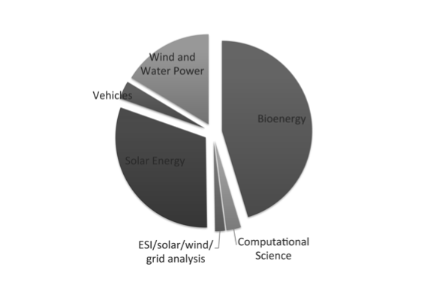
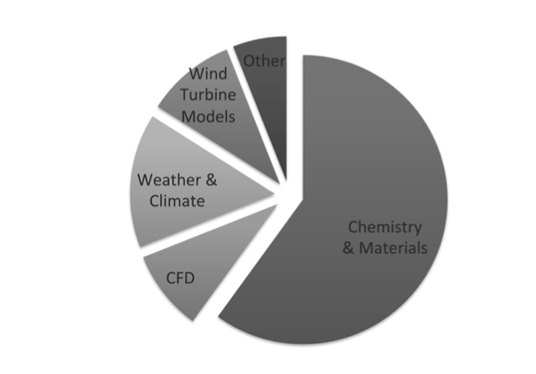
Peregrine @ NREL
Primary use in solar, wind and water, and bioenergy
Peregrine focused on chemistry and material science
Climate and turbine considerations
Live Green
Notes:
Peregrines node hours are applied to bin areas of study. The most predominant ones are solar energy, bioenergy, and wind and water power. Within these areas Peregrine is focused on adapting material physics in order to commercialize complex problems surrounding creation of structures. It also largely tackles the task of bioenergy and its availability to convert into advanced biofuels through natural, non-consumable resources. Their VASP simulation program highlighted high performance computing’s analytical capabilities in solving material issues such as transition-state energies and surface reaction. They also used a weather research and forecasting model to produce forecasting graphics in order to maximize the use of solar and wind energy.

Slide 10
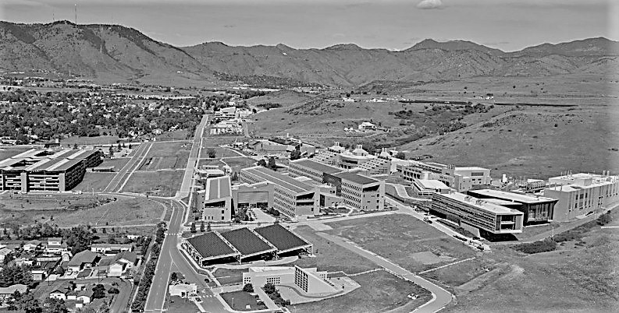
Peregrine to Eagle
In January of 2019 NREL put Eagle into production
Same system, but bigger
Live Green
Notes:
NREL released the second generation of the Peregrine supercomputer, Eagle, which has been selected by the United States Department of energy. It features a whopping 8 petaflops of peak speed performance and almost double the compute nodes. It is essentially a larger scale peregrine which still maintains its energy efficiency through warm water cooling and waste heat recovery to power all other parts of NREL.

Slide 11
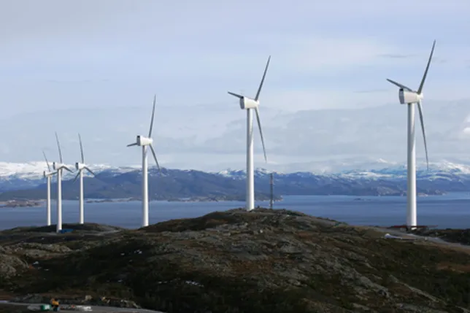
Summit
Large market for supercomputing
GE & Summit
Coastal jet levels
Frontier to come (exascale)
Live Green
Notes:
Of course NREL is not the only institution working on renewable energy through supercomputer calculations. The IBM Summit supercomputer at Oak Ridge National Laboratory is intended to perform calculations on coastal jet levels in order to optimize wind energy. GE is trying to join in on both NREL and ORNL’s renewable energy for commercial use for wind farms. Summit is already the second fastest operating at 200 petaflops and able to perform 200 quadrillion calculations per second. ORNL is also working on a supercomputer called Frontier, an exascale supercomputer which is supposed to be fifty times faster than Summit.

Slide 12
Summit
https://youtube.com/clip/UgkxMuS770xsVS2GI8-zXpt0JK4DNXgAIq0x
Live Green
Notes:
Here is a video of how Summit is using simulation and running GPU’s in parallel to better understand material science. The beginning starts off discussing how they plan to multiply their findings. Hopefully you can see how their simulating supernovas could help arrive to similar conclusions surrounding data collection and simulation on energy.

Slide 13

Limitations
Summit uses a LOT of energy
Not only focused on renewable energy
Is it more important to solve climate issues fast?
Live Green
Notes:
Summit and Peregrine do pose some limitations and considerations. The Summit high performance computer uses 15 MW of energy which is a great deal. In fact a lot of this energy isn’t even going into renewable energy research. On the other hand, Peregrine is not remotely close to as fast as Summit when it comes to calculations. It begs the question of whether we want the most powerful supercomputer in the world or the most sustainable one. This is an incredibly difficult question to answer and brings up environmental ethics once again. The Peregrine to Eagle upgrade is a remarkable one, and if sustainable warm water-cooling technology continues to improve, holdup and speeds continue to multiply like they have from 2015-2019 I would think that it might be more valuable than the world’s fastest supercomputer.

Slide 14
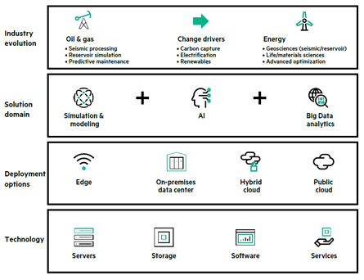
HPC, AI, and Renewable Energy
HPC is moving towards exascale
HPE and Cray
AI
Exascale
Live Green
Notes:
HPE is looking to use its Cray supercomputer to look into storage, transportation, and generation of renewable energy. Applications of artificial intelligence into supercomputing is proving to be more and more necessary into developing innovative solutions. AI has the potential to manage flexibility regarding supply and demand in energy use and storage to manage environmental crises happening around us such as a polar freeze in Texas as we’ve witnessed historically. Exascale supercomputers are also looking to be the future of renewable energy. Insights about energy consumption will be able to be produced far faster than what we can produce today. All aforementioned companies are currently working on exascale solutions.

Slide 15


Financial Prosperities
Notes:
Funding regarding high performance computing and energy is happening pretty commonly now among institutions as it is one of the main focuses of this day and age. Stanford is funding engineers millions of dollars a year in order to use high performance computing on solar energy which they are also looking into exascale high performance computing for. The united states department of energy is also working on funding high performance computing solutions to energy as it is pertinent to our country’s longevity. The us department of energy has worked with NREL in the past as well as ORNL to fund and apply their high performance computing solutions to American Problems.

Slide 16

Further Exploration
NREL & Exascale
Notes:
In NREL’S endeavors to use 3D modeling of wind flow for wind energy. They are aiming to improve wind energy efficiency by 4-5% using said 3D modeling. They also hope to produce a predictive wind farm simulation which is why I’d also like to further look into AI and it’s considerations in the future of high performance computing as I would like to see its benefits on predictive methods. Also, NREL aims for this wind farm simulation to be be run on exascale computers in the near future according to a news release from 2016.

Slide 17
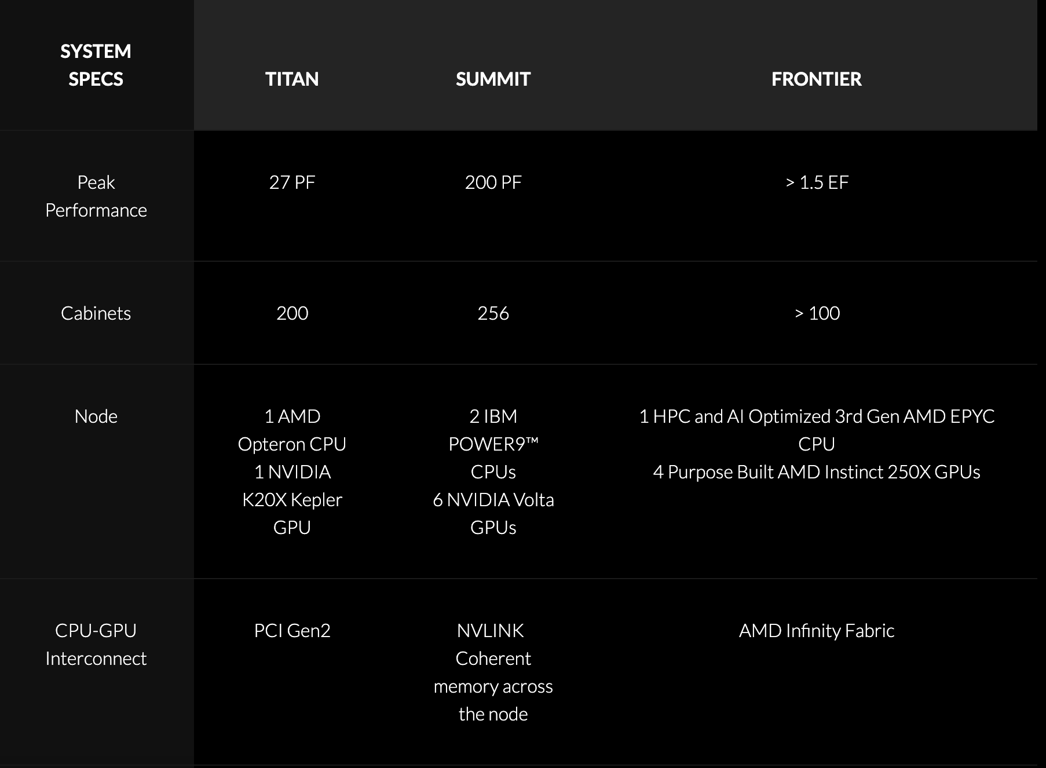
Further Exploration
ORNL, HPE, AMD & Exascale
Notes:
ORNL, HPE, and AMD are set to release their new Exascale high performance computer called Frontier which is almost like an exascale version of summit. It is said to be 50 times faster than summit with pretty much double to quadruple all of summits old specs. There is not much discussion around how Frontier will work around renewable energy, but I am hoping that it will continue simulations regarding solar and wind energy given its high and fast processing power.

Slide 18
Thank you!

Slide 19
References
https://www.youtube.com/watch?v=56N0_8Fa1pg&t=95s
https://www.olcf.ornl.gov/olcf-resources/compute-systems/summit/summit-faqs/
https://www.hpe.com/psnow/doc/a00094635enw.html?jumpid=in_pdp-psnow-qs
https://www.hpe.com/us/en/compute/hpc/supercomputing.html?jumpid=ps_mdypzk7g6s_aid-520061464&ef_id=5d59602b0e571008f84c02194a2ec091:G:s&s_kwcid=AL!13472!10!81776266304351!81776374026086&
https://www.zdnet.com/article/summit-supercomputer-to-advance-research-on-wind-power-for-renewable-energy/
https://www.timesunion.com/business/article/GE-riding-supercomputer-to-renewable-energy-future-16422950.php
https://eehpcwg.llnl.gov/
https://www.newsnationnow.com/us-news/rising-gas-prices-hit-farmers-the-hardest/
https://www.caceonline.org/history.html
https://www.cedamia.org/global/
https://www.computerworld.com/article/3431148/why-data-centres-are-the-new-frontier-in-the-fight-against-climate-change.html
https://49w2iv8hjjd3vl0kkk4r0yxc-wpengine.netdna-ssl.com/wp-content/uploads/2021/09/EE-HPC-SOP-2019-Designing-an-Energy-Efficient-HPC-Supercomputing-Center.pdf
https://www.energy.gov/eere/articles/department-energy-announces-3-million-high-performance-computing-research-national
https://www.nrel.gov/news/press/2016/37739.html
https://www.energy.gov/eere/articles/department-energy-announces-3-million-high-performance-computing-research-national
https://en.wikipedia.org/wiki/Supercomputer#Energy_usage_and_heat_management
https://news.stanford.edu/news/2013/august/supercomputing-solar-efficiency-080113.html
https://crd.lbl.gov/assets/pubs_presos/CDS/ATG/powereffreportfull.pdf
https://etn.global/wp-content/uploads/2017/12/Press_Release_EUChinaSummit2015.pdf
https://www.hpcwire.com/2021/09/16/whats-new-in-hpc-research-solar-power-exaworks-optane-more/
https://www.hpcwire.com/off-the-wire/renewable-energy-project-plugs-hpc-wales/
https://www.delltechnologies.com/asset/da-dk/products/ready-solutions/industry-market/hpc-energy-oil-gas-guide.pdf
https://etn.global/research-innovation/projects/omsop/
https://www.netapp.com/data-storage/high-performance-computing/what-is-hpc/
https://researchcomputing.princeton.edu/faq/what-is-a-cluster
https://www.digitalengineering247.com/article/winds-of-change/
Live Green

